Slide 1
June 2017
Core epidemiology slides

Slide 2
Global summary of the AIDS epidemic  2016
Number of people living with HIV
Total
Adults
Women (15+ years)
Children (<15 years)
Total
Adults
Children (<15 years)
Total
Adults
Children (<15 years)
36.7 million [30.8 million–42.9 million]
34.5 million [28.8 million–40.2 million]
17.8 million [15.4 million–20.3 million]
2.1 million [1.7 million–2.6 million]
1.8 million [1.6 million–2.1 million]
1.7 million [1.4 million–1.9 million]
160 000 [100 000–220 000]
1.0 million [830 000–1.2 million]
890 000 [740 000–1.1 million]
120 000 [79 000–160 000]
People newly infected
with HIV in 2016
AIDS-related deaths in 2016

Slide 3
Global estimates for adults and children  2016
People living with HIV 36.7 million [30.8 million–42.9 million]
New HIV infections in 2016 1.8 million [1.6 million–2.1 million]
AIDS-related deaths in 2016 1.0 million [830 000–1.2 million]

Slide 4
About 5000 new HIV infections (adults and children) a day  2016
About 64% are in sub-Saharan Africa
About 400 are among children under 15 years of age
About 4500 are among adults aged 15 years and older, of whom:
  ─ almost 43% are among women
  ─ about 37% are among young people (15–24)
  ─ about 22% are among young women (15–24)

Slide 5
Global estimates for children (<15 years)  2016
Children living with HIV 2.1 million [1.7 million–2.6 million]
New HIV infections in 2016 160 000 [100 000–220 000]
AIDS-related deaths in 2016 120 000 [79 000–160 000]

Slide 6
Regional HIV and AIDS statistics and features  2016
Adults and children living with HIV
Adults and children newly infected with HIV
Adult & child
deaths due to AIDS
Eastern and southern Africa
19.4 million
[17.8 million–21.1 million]
790 000
[710 000–870 000]
420 000
[350 000–510 000]
Western and central Africa
6.1 million
[4.9 million–7.6 million]
370 000
[270 000–490 000]
310 000
[220 00–400 000]
Middle East and North Africa
230 000
[160 000–380 000]
18 000
[11 000–39 000]
11 000
[7700–19 000]
Asia and the Pacific
5.1 million
[3.9 million–7.2 million]
270 000
[190 000–370 000]
170 000
[130 000–220 000]
Latin America
1.8 million
[1.4 million–2.1 million]
97 000
[79 000–120 000]
36 000
[28 000–45 000]
Caribbean
310 000
[280 000–350 000]
18 000
[15 000–22 000]
9400
[7300–12 000]
Eastern Europe and central Asia
1.6 million
[1.4 million–1.7 million]
190 000
[160 000–220 000]
40 000
[32 000–49 000]
Western and central Europe and
North America
2.1 million
[2.0 million–2.3 million]
73 000
[68 000–78 000]
18 000
[15 000–20 000]
TOTAL
36.7 million
[30.8 million–42.9 million]
1.8 million
[1.6 million–2.1 million]
1.0 million
[830 000–1.2 million]
The ranges around the estimates in this table define the boundaries within which the actual numbers lie, based on the best available information.

Slide 7
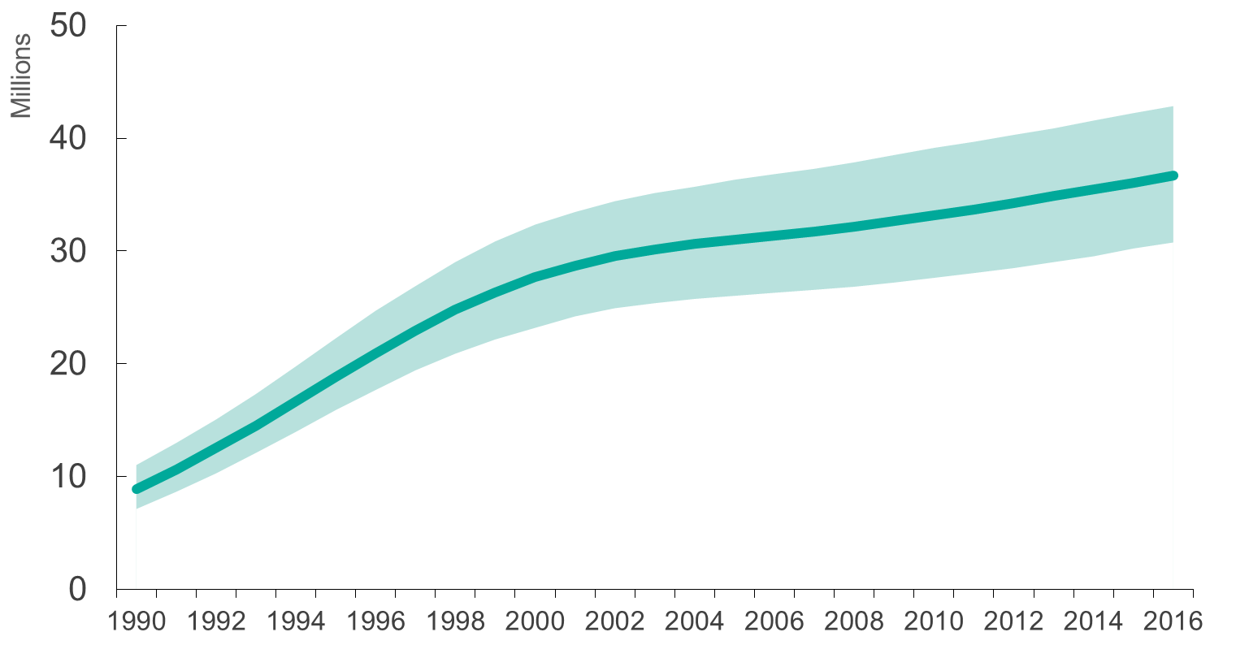
Adults and children estimated to be living with HIV  1990–2016
Adults and children estimated to be living with HIV
Range of uncertainty

Slide 8
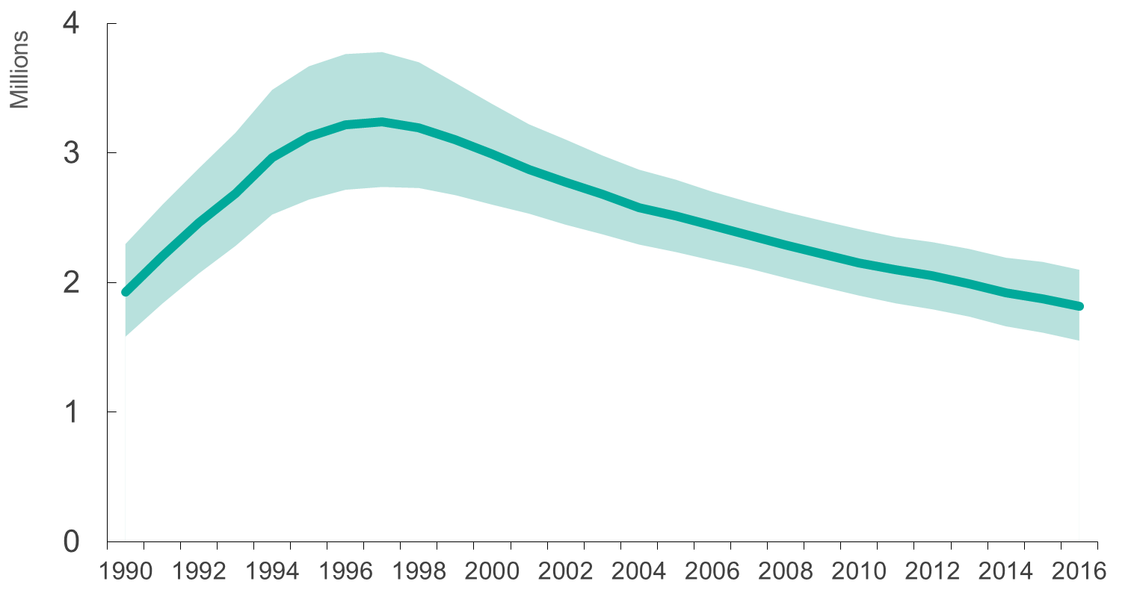
Adults and children newly infected with HIV 1990–2016
Adults and children newly infected with HIV
Range of uncertainty

Slide 9
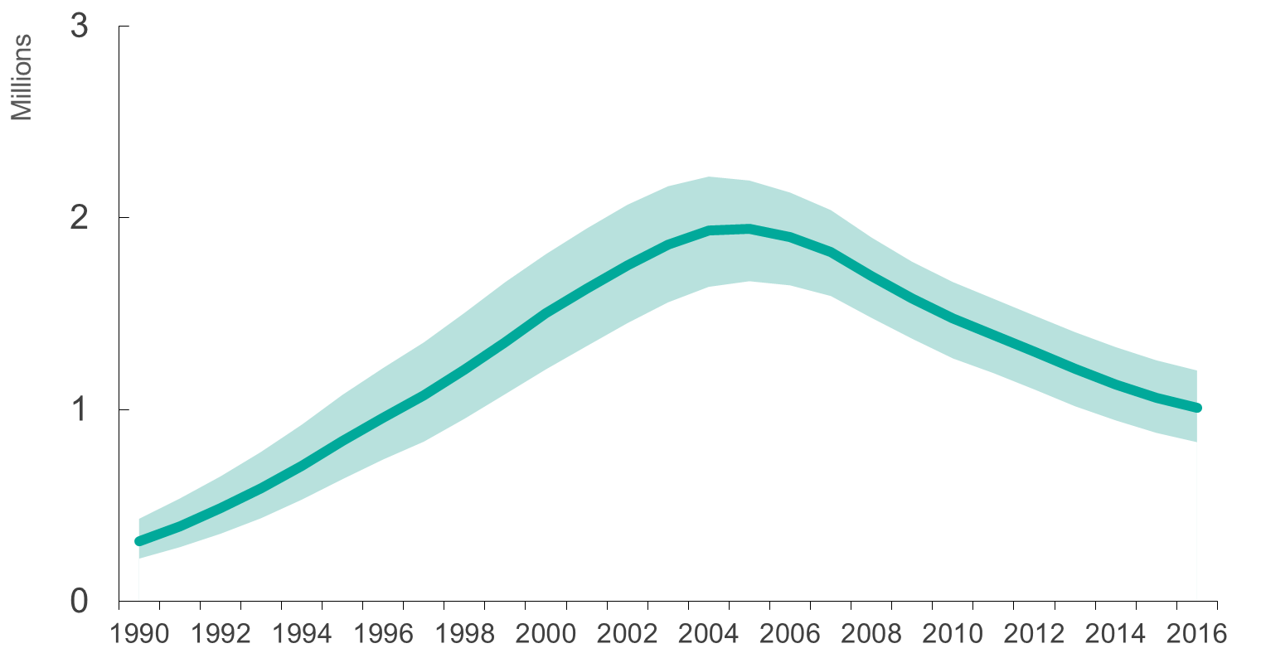
Adult & child deaths due to AIDS  1990–2016
Adult & child deaths due to AIDS
Range of uncertainty

Slide 10
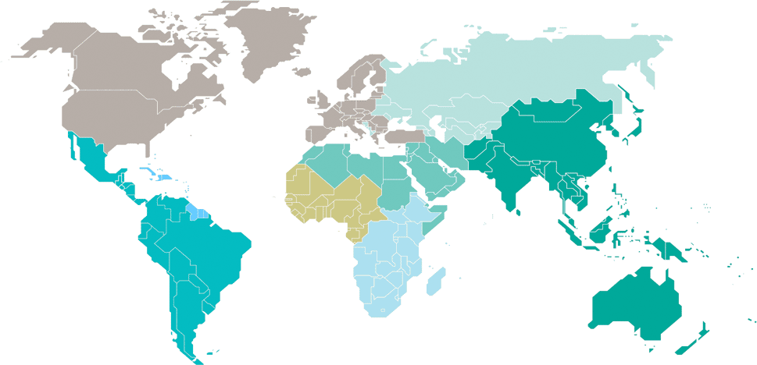
Adults and children estimated to be living with HIV  2016
Eastern Europe
and central Asia
1.6 million
[1.4 million–1.7 million]
North America and western and central Europe
2.1 million
[2.0 million–2.3 million]
Caribbean
310 000
[280 000–350 000]
Middle East and North Africa
230 000
[160 000–380 000]
Western and central Africa
6.1 million
[4.9 million–7.6 million]
Asia and the Pacific
5.1 million
[3.9 million–7.2 million]
Latin America
1.8 million
[1.4 million–2.1 million]
Eastern and southern Africa
19.4 million
[17.8 million–21.1 million]
Total: 36.7 million [30.8 million–42.9 million]

Slide 11
Estimated number of adults and children newly infected with HIV  2016
Eastern Europe
and central Asia
190 000
[160 000–220 000]
North America and western and central Europe
73 000
[68 000–78 000]
Caribbean
18 000
[15 000–22 000]
Middle East and North Africa
18 000
[11 000–39 000]
Western and central Africa
370 000
[270 000–490 000]
Asia and the Pacific
270 000
[190 000–370 000]
Latin America
97 000
[79 000–120 000]
Eastern and southern Africa
790 000
[710 000–870 000]
Total: 1.8 million [1.6 million–2.1 million]

Slide 12
Estimated adult and child deaths from AIDS  2016
Eastern Europe
and central Asia
40 000
[32 000–49 000]
North America and western and central Europe
18 000
[15 000–20 000]
Caribbean
9400
[7300–12 000]
Middle East and North Africa
11 000
[7700–19 000]
Western and central Africa
310 000
[220 000–400 000]
Asia and the Pacific
170 000
[130 000–220 000]
Latin America
36 000
[28 000–45 000]
Eastern and southern Africa
420 000
[350 000–510 000]
Total: 1.0 million [830 000–1.2 million]

Slide 13
Children (<15 years) estimated to be living with HIV  2016
Eastern Europe
and central Asia
…*
North America and western and central Europe
…*
Caribbean
10 000
[8700–12 000]
Middle East and North Africa
9300
[7100–16 000]
Western and central Africa
550 000
[390 000–730 000]
Asia and the Pacific
190 000
[130 000–280 000]
Latin America
24 000
[20 000–29 000]
Eastern and southern Africa
1.3 million
[1.1 million–1.6 million]
Total: 2.1 million [1.7 million–2.6 million]

Slide 14
Estimated number of children (<15 years) newly infected with HIV  2016
Eastern Europe
and central Asia
…*
North America and western and central Europe
…*
Caribbean
<1000
[<1000 – <1000]
Middle East and North Africa
1400
[<1000–3300]
Western and central Africa
60 000
[35 000–89 000]
Asia and the Pacific
15 000
[7700–26 000]
Latin America
1800
[1300–2400]
Eastern and southern Africa
77 000
[52 000–110 000]
Total: 160 000 [100 000–220 000]

Slide 15
Estimated deaths in children (<15 years) from AIDS  2016
Eastern Europe
and central Asia
…*
North America and western and central Europe
…*
Caribbean
<1000
[<500 – <1000]
Middle East and North Africa
<1000
[<1000–1900]
Western and central Africa
43 000
[27 000–62 000]
Asia and the Pacific
11 000
[6800–16 000]
Latin America
1400
[1000–1900]
Eastern and southern Africa
58 000
[41 000–80 000]
Total: 120 000 [79 000–160 000]

