Slide 1
July 2018
Core epidemiology slides

Slide 2
Global summary of the AIDS epidemic  2017
Number of people living with HIV
Total
Adults
Women (15+ years)
Children (<15 years)
Total
Adults
Children (<15 years)
Total
Adults
Children (<15 years)
36.9 million [31.1 million–43.9 million]
35.1 million [29.6 million–41.7 million]
18.2 million [15.6 million–21.4 million]
1.8 million [1.3 million–2.4 million]
1.8 million [1.4 million–2.4 million]
1.6 million [1.3 million–2.1 million]
180 000 [110 000–260 000]
940 000 [670 000–1.3 million]
830 000 [590 000–1.2 million]
110 000 [63 000–160 000]
People newly infected
with HIV in 2017
AIDS-related deaths in 2017

Slide 3
Global estimates for adults and children  2017
People living with HIV 36.9 million [31.1 million–43.9 million]
New HIV infections in 2017 1.8 million [1.4 million–2.4 million]
AIDS-related deaths in 2017 940 000 [670 000–1.3 million]

Slide 4
About 5000 new HIV infections (adults and children) a day  2017
About 66% are in sub-Saharan Africa
About 500 are among children under 15 years of age
About 4400 are among adults aged 15 years and older, of whom:
  ─ almost 43% are among women
  ─ about 33% are among young people (15–24)
  ─ about 19% are among young women (15–24)

Slide 5
Global estimates for children (<15 years)  2017
Children living with HIV 1.8 million [1.3 million–2.4 million]
New HIV infections in 2017 180 000 [110 000–260 000]
AIDS-related deaths in 2017 110 000 [63 000–160 000]

Slide 6
Regional HIV and AIDS statistics and features  2017
Adults and children living with HIV
Adults and children newly infected with HIV
Adult and child
deaths due to AIDS
Eastern and southern Africa
19.6 million
[17.5 million–22.0 million]
800 000
[650 000–1.0 million]
380 000
[300 000–510 000]
Western and central Africa
6.1 million
[4.4 million–8.1 million]
370 000
[220 000–570 000]
280 000
[180 00–410 000]
Middle East and North Africa
220 000
[150 000–300 000]
18 000
[10 000–31 000]
9800
[6400–15 000]
Asia and the Pacific
5.2 million
[4.1 million–6.7 million]
280 000
[210 000–390 000]
170 000
[110 000–280 000]
Latin America
1.8 million
[1.5 million–2.3 million]
100 000
[77 000–130 000]
37 000
[26 000–51 000]
Caribbean
310 000
[260 000–420 000]
15 000
[11 000–26 000]
10 000
[7100–17 000]
Eastern Europe and central Asia
1.4 million
[1.3 million–1.6 million]
130 000
[120 000–150 000]
34 000
[25 000–41 000]
Western and central Europe and
North America
2.2 million
[1.9 million–2.4 million]
70 000
[57 000–84 000]
13 000
[9900–18 000]
TOTAL
36.9 million
[31.1 million–43.9 million]
1.8 million
[1.4 million–2.4 million]
940 000
[670 000–1.3 million]
The ranges around the estimates in this table define the boundaries within which the actual numbers lie, based on the best available information.

Slide 7
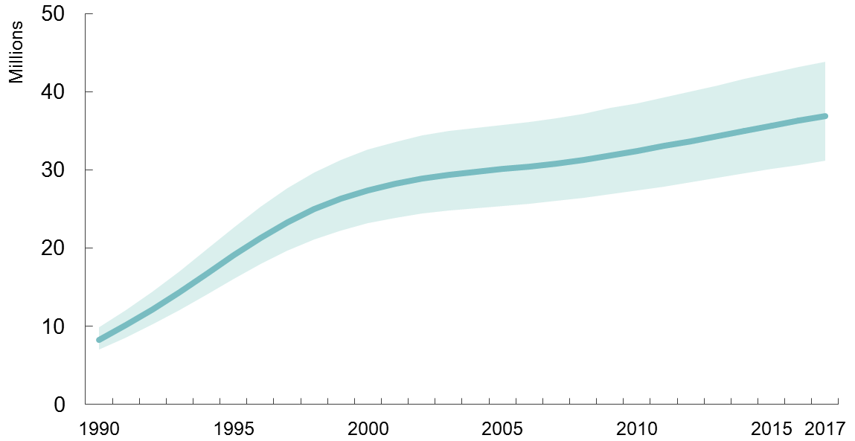
Adults and children estimated to be living with HIV  1990–2017
Adults and children estimated to be living with HIV
Range of uncertainty

Slide 8
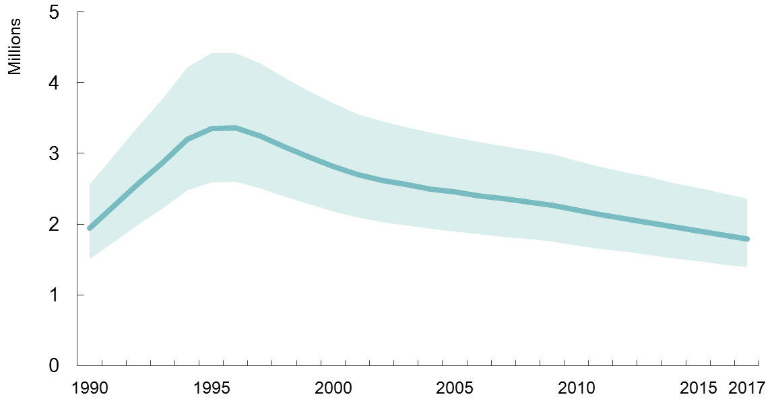
Adults and children newly infected with HIV 1990–2017
Adults and children newly infected with HIV
Range of uncertainty

Slide 9
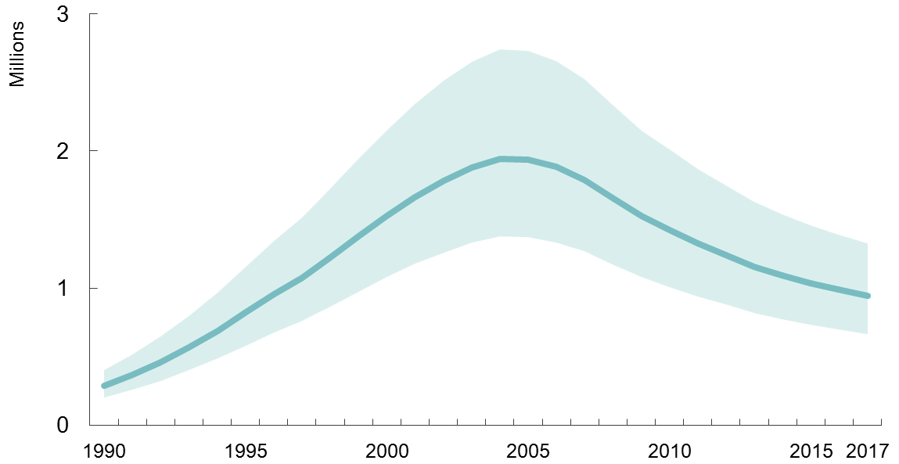
Adult and child deaths due to AIDS  1990–2017
Adult and child deaths due to AIDS
Range of uncertainty

Slide 10
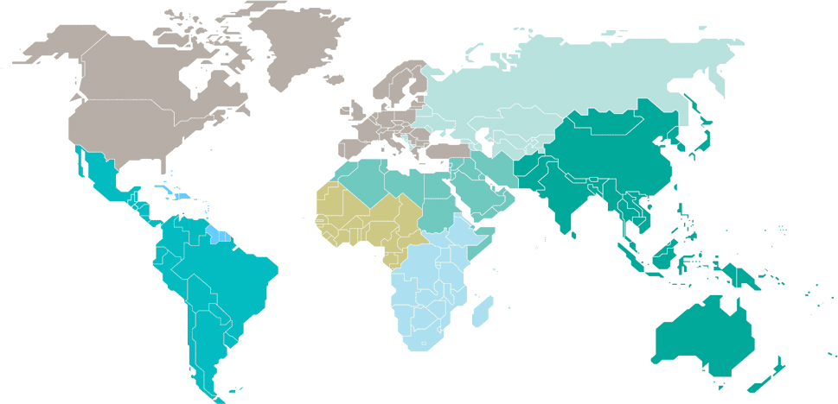
Adults and children estimated to be living with HIV  2017
Eastern Europe
and central Asia
1.4 million
[1.3 million–1.6 million]
North America and western and central Europe
2.2 million
[1.9 million–2.4 million]
Caribbean
310 000
[260 000–420 000]
Middle East and North Africa
220 000
[150 000–300 000]
Western and central Africa
6.1 million
[4.4 million–8.1 million]
Asia and the Pacific
5.2 million
[4.1 million–6.7 million]
Latin America
1.8 million
[1.5 million–2.3 million]
Eastern and southern Africa
19.6 million
[17.5 million–22.0 million]
Total: 36.9 million [31.1 million–43.9 million]

Slide 11
Estimated number of adults and children newly infected with HIV  2017
Eastern Europe
and central Asia
130 000
[120 000–150 000]
North America and western and central Europe
70 000
[57 000–84 000]
Caribbean
15 000
[11 000–26 000]
Middle East and North Africa
18 000
[10 000–31 000]
Western and central Africa
370 000
[220 000–570 000]
Asia and the Pacific
280 000
[210 000–390 000]
Latin America
100 000
[77 000–130 000]
Eastern and southern Africa
800 000
[650 000–1.0 million]
Total: 1.8 million [1.4 million–2.4 million]

Slide 12
Estimated adult and child deaths from AIDS  2017
Eastern Europe
and central Asia
34 000
[25 000–41 000]
North America and western and central Europe
13 000
[9900–18 000]
Caribbean
10 000
[7100–17 000]
Middle East and North Africa
9800
[6400–15 000]
Western and central Africa
280 000
[180 000–410 000]
Asia and the Pacific
170 000
[110 000–280 000]
Latin America
37 000
[26 000–51 000]
Eastern and southern Africa
380 000
[300 000–510 000]
Total: 940 000 [670 000–1.3 million]

Slide 13
Children (<15 years) estimated to be living with HIV  2017
Eastern Europe
and central Asia
…*
North America and western and central Europe
…*
Caribbean
9900
[7400–15 000]
Middle East and North Africa
8200
[6000–11 000]
Western and central Africa
500 000
[320 000–690 000]
Asia and the Pacific
110 000
[82 000–150 000]
Latin America
27 000
[19 000–36 000]
Eastern and southern Africa
1.2 million
[880 000–1.4 million]
Total: 1.8 million [1.3 million–2.4 million]
*Estimates for children are not published because of small numbers.

Slide 14
Estimated number of children (<15 years) newly infected with HIV  2017
Eastern Europe
and central Asia
…*
North America and western and central Europe
…*
Caribbean
1100
[710 – 1900]
Middle East and North Africa
1300
[780–1900]
Western and central Africa
67 000
[36 000–100 000]
Asia and the Pacific
10 000
[7400–14 000]
Latin America
2400
[1800–3600]
Eastern and southern Africa
92 000
[61 000–130 000]
Total: 180 000 [110 000–260 000]
*Estimates for children are not published because of small numbers.

Slide 15
Estimated deaths in children (<15 years) from AIDS  2017
Eastern Europe
and central Asia
…*
North America and western and central Europe
…*
Caribbean
700
[<500 – 1300]
Middle East and North Africa
800
[500–1200]
Western and central Africa
45 000
[24 000–69 000]
Asia and the Pacific
6400
[4100–10 000]
Latin America
1700
[1200–2600]
Eastern and southern Africa
52 000
[31 000–78 000]
Total: 110 000 [63 000–160 000]
*Estimates for children are not published because of small numbers.

