Slide 1
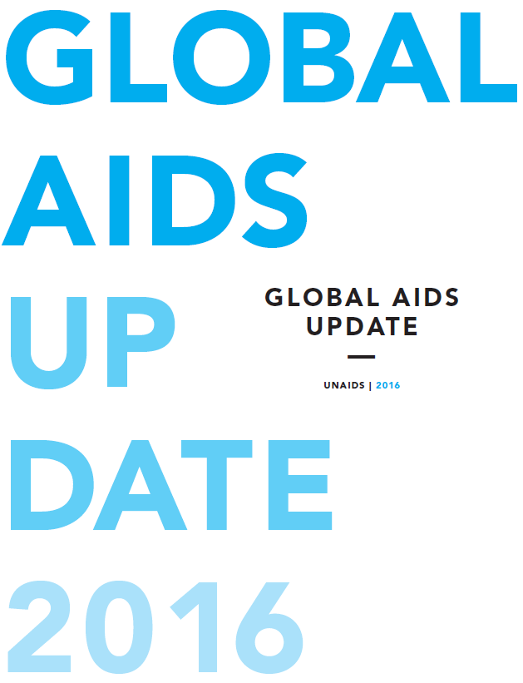


Slide 2
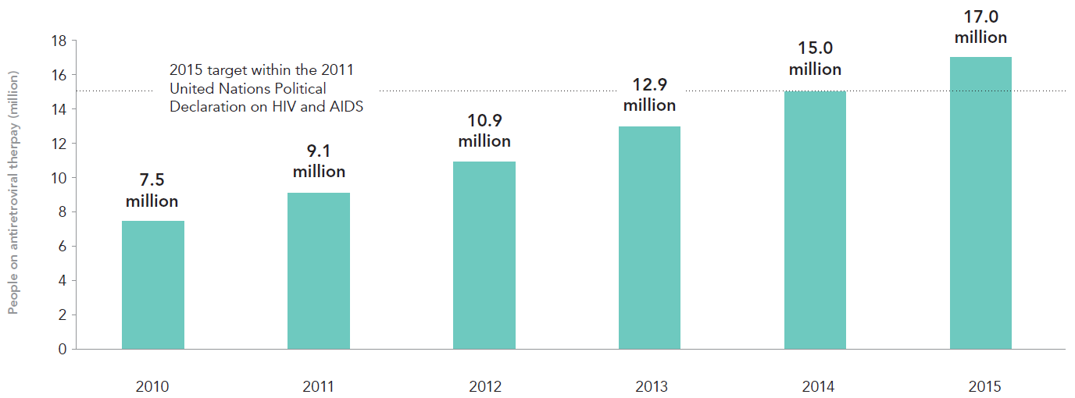
Number of people living with HIV on antiretroviral therapy, global, 2010–2015
2015 target within the 2011 United Nations Political Declaration on HIV and AIDS
Sources: Global AIDS Response Progress Reporting (GARPR) 2016; UNAIDS 2016 estimates.

Slide 3
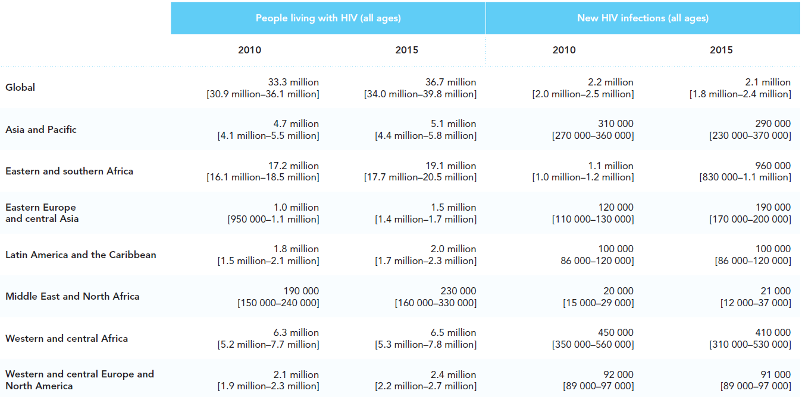
HIV epidemic and response estimates, global and by region, 2010 and 2015
People living with HIV (all ages)
New HIV infections (all ages)
Global
Asia and Pacific
Eastern and southern Africa
Eastern Europe
and Central Asia
Latin America
and the Caribbean
Middle East
and North Africa
Western and central Africa
Western and central Europe
and North America
Sources: GARPR 2016; UNAIDS 2016 estimates.

Slide 4
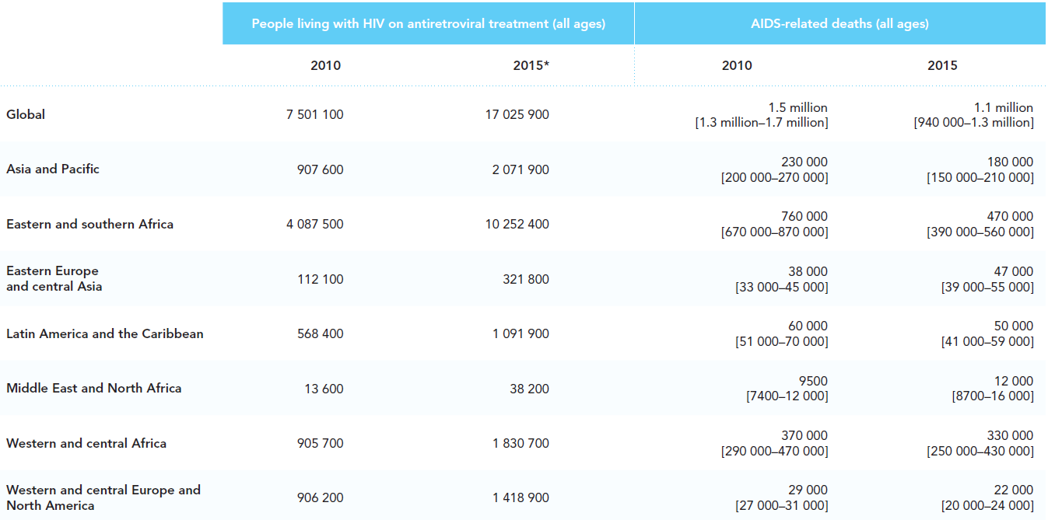
HIV epidemic and response estimates, global and by region, 2010 and 2015
People living with HIV
on antiretroviral treatment (all ages)
AIDS-related deaths (all ages)
Global
Asia and Pacific
Eastern and southern Africa
Eastern Europe
and Central Asia
Latin America
and the Caribbean
Middle East
and North Africa
Western and central Africa
Western and central Europe
and North America
* Difference in global and regional sums due to rounding.
Sources: GARPR 2016; UNAIDS 2016 estimates.

Slide 5
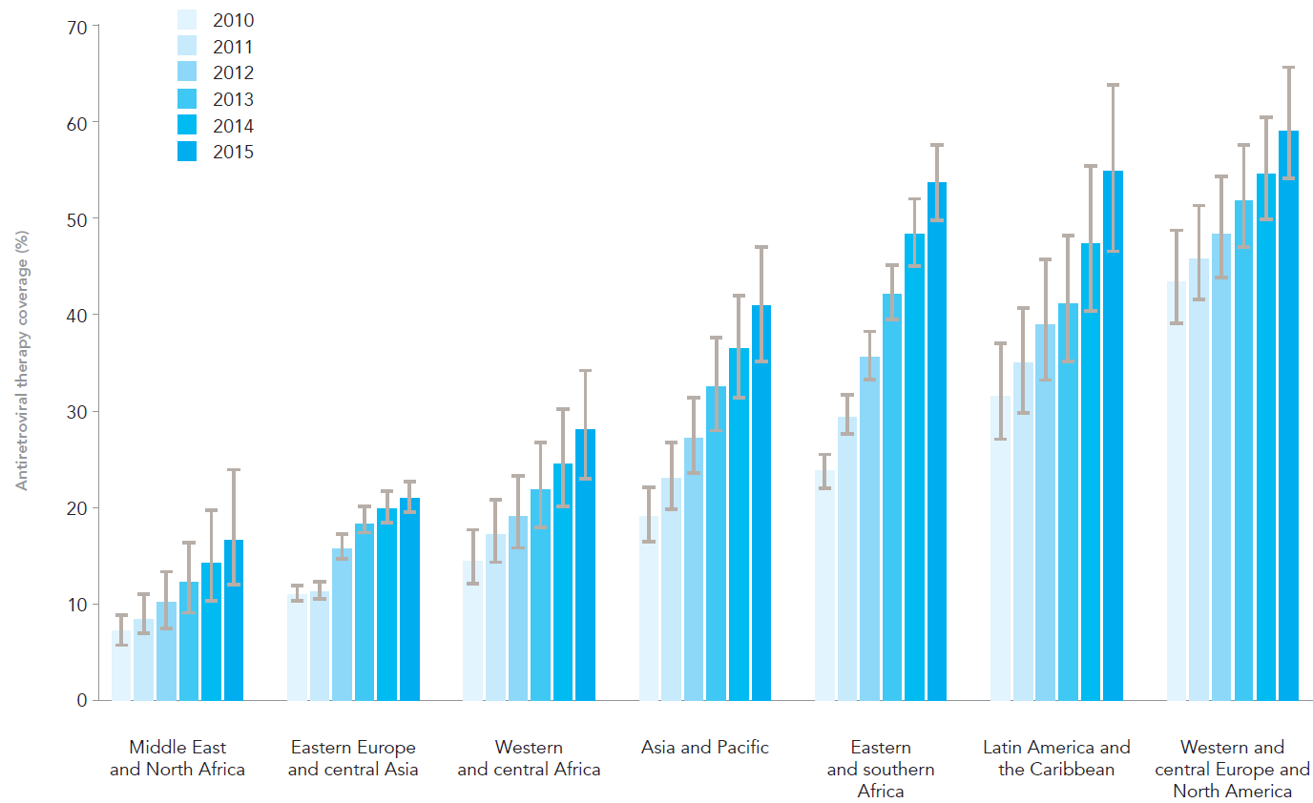
Antiretroviral therapy coverage among people living with HIV, by region, 2010–2015
Middle
East and
North
Africa
Eastern
Europe and
central
Asia
Western
and central
Africa
Asia and
Pacific
Eastern
and
southern
Africa
Latin
America
and the
Caribbean
Western
and central
Europe and
North
America
Sources: GARPR 2016; UNAIDS 2016 estimates.

Slide 6
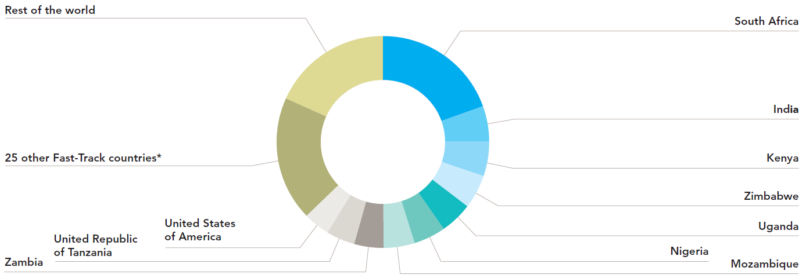
Distribution of antiretroviral therapy, by country, 2015
* The Fast-Track countries include the 10 displayed on this chart, plus Angola, Botswana, Brazil, Cameroon, Chad, China, Côte d’Ivoire, Democratic Republic of the Congo, Ethiopia, Ghana, Haiti, Indonesia, Iran (Islamic Republic of), Jamaica, Lesotho, Malawi, Mali, Myanmar, Namibia, Pakistan, South Sudan, Swaziland, Russian Federation, Ukraine and Viet Nam.
Sources: GARPR 2016; UNAIDS 2016 estimates.

Slide 7
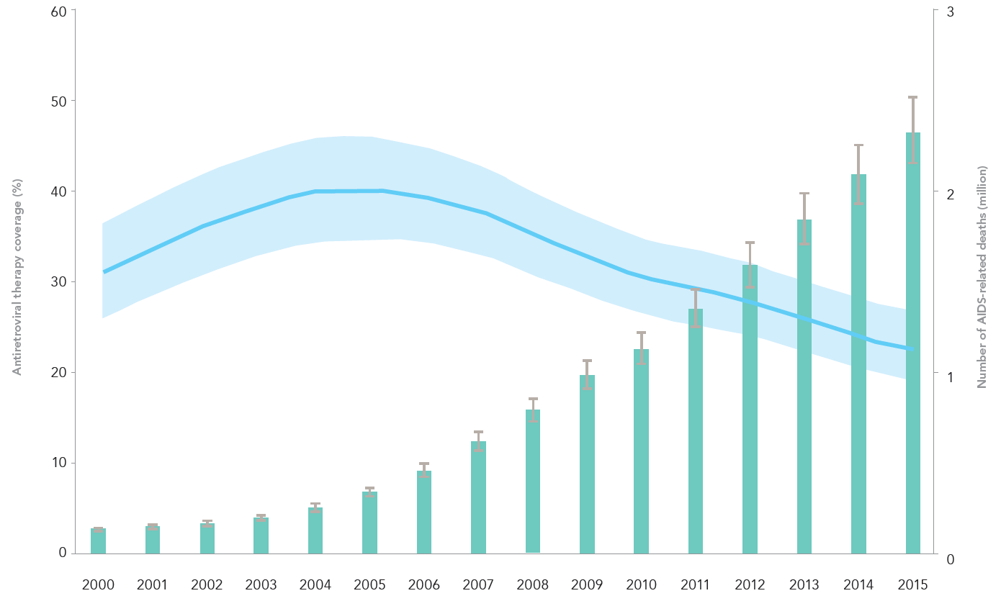
Antiretroviral therapy coverage and number of
AIDS-related deaths, global, 2000–2015
Sources: GARPR 2016; UNAIDS 2016 estimates.

Slide 8
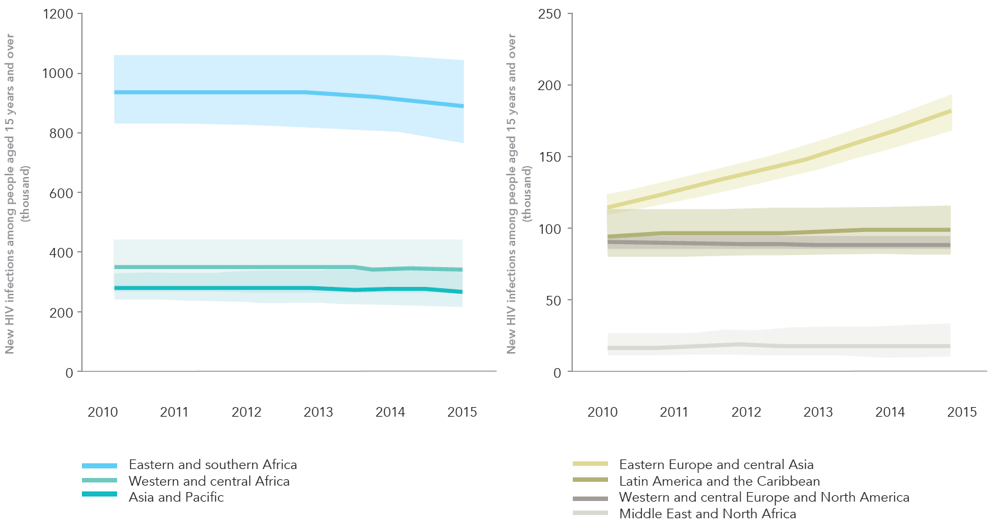
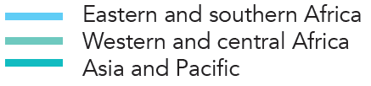
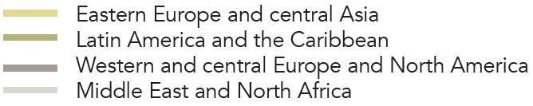
New HIV infections among people aged 15 years and over, by region, 2010–2015
Source: UNAIDS 2016 estimates.

Slide 9
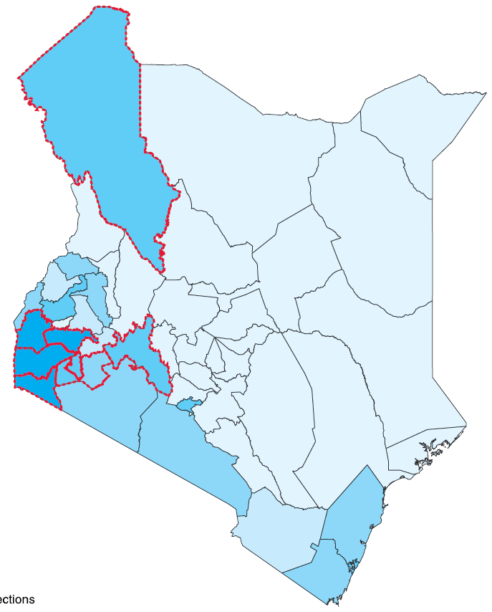
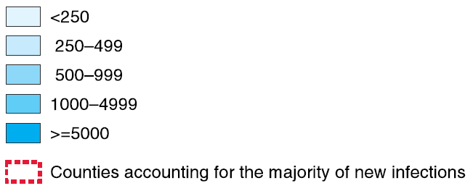
Estimated new HIV infections by county, Kenya, 2014
Sources: UNAIDS 2015 estimates; Kenya Ministry of Health.

Slide 10
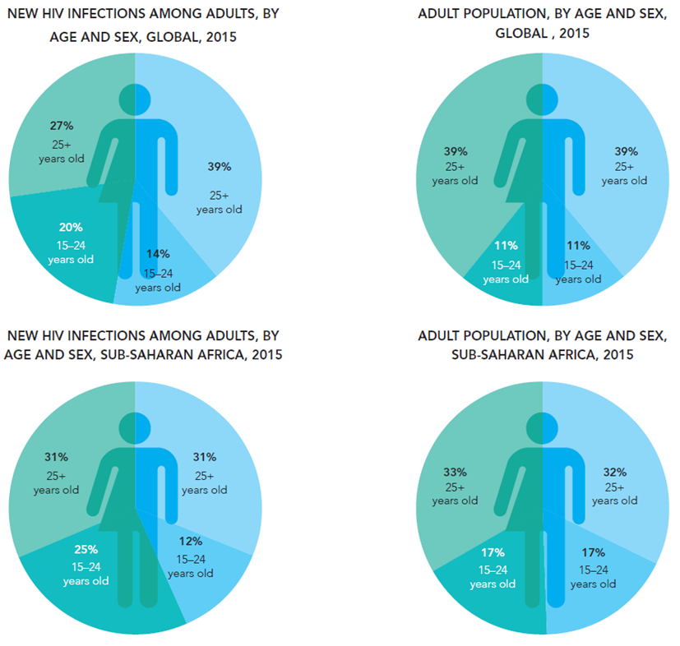
Distribution of new adult HIV infections and population by age and sex, global and in sub-Saharan Africa, 2015
NEW HIV INFECTIONS AMONG ADULTS,
BY AGE AND SEX, GLOBAL, 2015
ADULT POPULATION, BY AGE AND SEX,
GLOBAL, 2015
NEW HIV INFECTIONS AMONG ADULTS,
BY AGE AND SEX, SUB-SAHARAN AFRICA, 2015
ADULT POPULATION, BY AGE AND SEX,
SUB-SAHARAN AFRICA, 2015
Source: UNAIDS 2016 estimates.

Slide 11
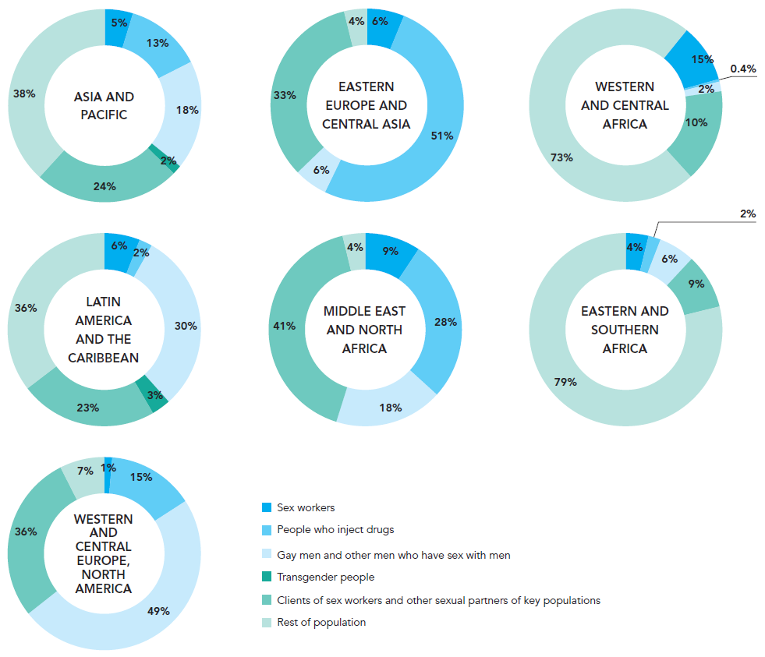
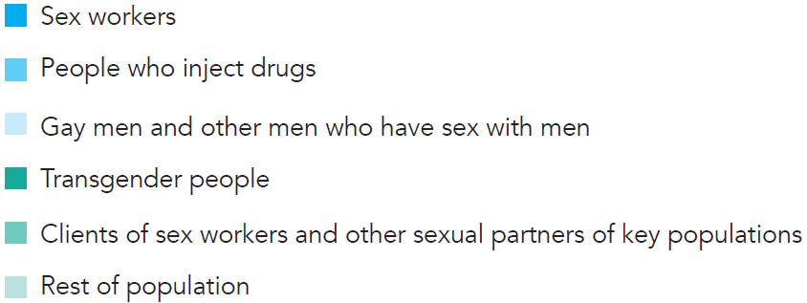
Distribution of new HIV infections among population groups, by region, 2014
Methodological note: Estimated numbers of new HIV infections by key population were compiled from country Spectrum files submitted in 2015 to UNAIDS (2014 data), available modes-of-transmission studies and additional sources of data drawn from GARPR reports. Where data were lacking, regional medians were calculated from available data and applied to countries’ populations.
Source: UNAIDS special analysis, 2016.

Slide 12
