Slide 1
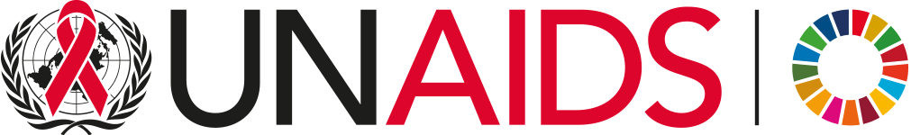
September 2026
Core epidemiology slides

Slide 2
Global estimates for adults and children  2025
People living with HIV 41.0 million [35.3 million – 47.5 million]
New HIV infections 1.2 million [950 000 – 1.7 million]
Deaths due to AIDS 570 000 [430 000 – 780 000]
Source: UNAIDS 2026 epidemiological estimates

Slide 3
About 3400 new HIV infections (adults and children) a day  2025
About 50% are in sub-Saharan Africa
About 250 are among children under 15 years of age
About 3100 are among adults aged 15 years and older, of whom:
  ─ 1400 are among adult women
  ─ 1000 are among young people (15–24)
  ─ 540 are among young women (15–24)
Source: UNAIDS 2026 epidemiological estimates

Slide 4
Global estimates for children (0-14 years)  2025
Children living with HIV 1.3 million [1.0 million – 1.7 million]
New HIV infections 93 000 [63 000 – 140 000]
Deaths due to AIDS 61 000 [39 000 – 90 000]
Source: UNAIDS 2026 epidemiological estimates

Slide 5
Regional HIV and AIDS statistics and features  2025
 | Adults and children living with HIV | Adults and children newly infected with HIV | Adult and child deaths due to AIDS
Asia and the Pacific | 7.1 million [6.3 million – 8.0 million] | 280 000 [230 000 – 360 000] | 120 000 [93 000 – 160 000]
Caribbean | 340 000 [290 000 – 400 000] | 13 000 [9300 – 19 000] | 4800 [3300 – 6900]
East and Southern Africa | 21.1 million [17.5 million – 24.8 million] | 420 000 [300 000 – 580 000] | 240 000 [190 000 – 350 000]
Eastern Europe and Central Asia | 2.0 million [1.8 million – 2.2 million] | 120 000 [100 000 – 140 000] | 43 000 [34 000 – 54 000]
Latin America | 2.6 million [2.3 million – 3.0 million] | 140 000 [100 000 – 180 000] | 28 000 [18 000 – 39 000]
Middle East and North Africa | 240 000 [200 000 – 300 000] | 22 000 [15 000 – 31 000] | 6600 [4400 – 9900]
West and Central Africa | 5.2 million [4.6 million – 6.1 million] | 190 000 [130 000 – 290 000] | 110 000 [84 000 – 150 000]
Western and central Europe and North America | 2.4 million [2.1 million – 2.7 million] | 63 000 [52 000 – 75 000] | 9800 [7300 – 12 000]
Global | 41.0 million [35.3 million – 47.5 million] | 1.2 million [950 000 – 1.7 million] | 570 000 [430 000 - 780 000]
The ranges around the estimates in this table define the boundaries within which the actual numbers lie, based on the best available information.
Source: UNAIDS 2026 epidemiological estimates

Slide 6
Number of new HIV infections, global, 1990–2025, 2025 and 2030 targets
Source: UNAIDS 2026 epidemiological estimates
Source: UNAIDS 2025 epidemiological estimates

Slide 7
Number of AIDS-related deaths, global, 1990–2025, 2025 and 2030 targets
Source: UNAIDS 2026 epidemiological estimates

Slide 8
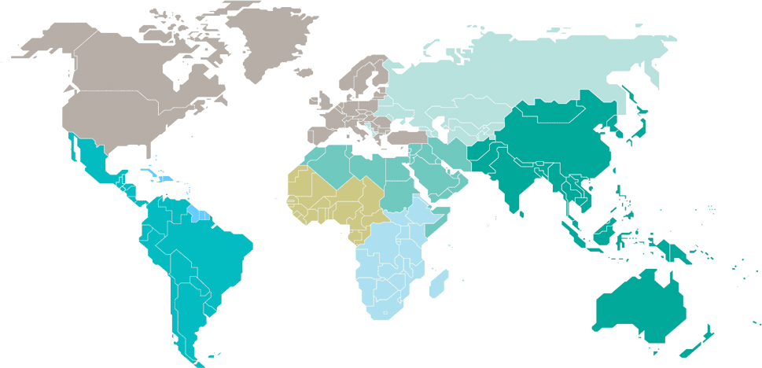
Adults and children estimated to be living with HIV  2025
Eastern Europe
and central Asia
2.0 million
[1.8 million – 2.2 million]
Western and central Europe and North America
2.4 million
[2.1 million – 2.7 million]
Caribbean
340 000
[290 000 – 400 000]
Middle East and North Africa
240 000
[200 000 – 300 000]
Western and central Africa
5.2 million
[4.6 million – 6.1 million]
Asia and the Pacific
7.1 million
[6.3 million – 8.0 million]
Latin America
2.6 million
[2.3 million – 3.0 million]
Eastern and southern Africa
21.1 million
[17.5 million – 24.8 million]
Total: 41.0 million [35.3 million – 47.5 million]
Source: UNAIDS 2026 epidemiological estimates

Slide 9
Estimated number of adults and children newly infected with HIV  2025
Eastern Europe
and central Asia
120 000
[100 000 – 140 000]
Western and central Europe and North America
63 000
[52 000 – 75 000]
Caribbean
13 000
[9300 – 19 000]
Middle East and North Africa
22 000
[15 000 – 31 000]
Western and central Africa
190 000
[130 000 – 290 000]
Asia and the Pacific
280 000
[230 000 – 360 000]
Latin America
140 000
[100 000 – 180 000]
Eastern and southern Africa
420 000
[300 000 – 580 000]
Total: 1.2 million [950 000 – 1.7 million]
Source: UNAIDS 2026 epidemiological estimates

Slide 10
Estimated adult and child deaths from AIDS  2025
Eastern Europe
and central Asia
43 000
[34 000 – 54 000]
Western and central Europe and North America
9800
[7300 – 12 000]
Caribbean
4800
[3300 – 6900]
Middle East and North Africa
6600
[4400 – 9900]
Western and central Africa
110 000
[84 000 – 150 000]
Asia and the Pacific
120 000
[93 000 – 160 000]
Latin America
28 000
[18 000 – 39 000]
Eastern and southern Africa
240 000
[190 000 – 350 000]
Total: 570 000 [430 000 – 780 000]
Source: UNAIDS 2026 epidemiological estimates

Slide 11
Children (0-14 years) estimated to be living with HIV  2025
Eastern Europe
and central Asia
16 000
[13 000 – 18 000]
Western and central Europe and North America
…*
Caribbean
11 000
[8700 – 14 000]
Middle East and North Africa
11 000
[8400 – 14 000]
Western and central Africa
320 000
[250 000 – 390 000]
Asia and the Pacific
100 000
[87 000 – 130 000]
Latin America
23 000
[19 000 – 28 000]
Eastern and southern Africa
780 000
[620 000 – 1.1 million]
*Estimates for children are not published because of small numbers.
Total: 1.3 million [1.0 million – 1.7 million]
Source: UNAIDS 2026 epidemiological estimates

Slide 12
Estimated number of children (0-14 years) newly infected with HIV  2025
Eastern Europe
and central Asia
1000
[780 – 1400]
Western and central Europe and North America
…*
Caribbean
1600
[1100 – 2300]
Middle East and North Africa
1700
[1200 – 2400]
Western and central Africa
32 000
[21 000 – 47 000]
Asia and the Pacific
8200
[6300 – 12 000]
Latin America
2400
[1800 – 3100]
Eastern and southern Africa
46 000
[30 000 – 71 000]
*Estimates for children are not published because of small numbers.
Total: 93 000 [63 000 – 140 000]
Source: UNAIDS 2026 epidemiological estimates

Slide 13
Estimated deaths in children (0-14 years) from AIDS  2025
Eastern Europe
and central Asia
510
[<500 – 710]
Western and central Europe and North America
…*
Caribbean
970
[610 – 1400]
Middle East and North Africa
1100
[740 – 1500]
Western and central Africa
22 000
[14 000 – 31 000]
Asia and the Pacific
5500
[3900 – 8600]
Latin America
1600
[1100 – 2200]
Eastern and southern Africa
29 000
[18 000 – 44 000]
*Estimates for children are not published because of small numbers.
Total: 61 000 [39 000 – 90 000]
Source: UNAIDS 2026 epidemiological estimates

