Slide 1
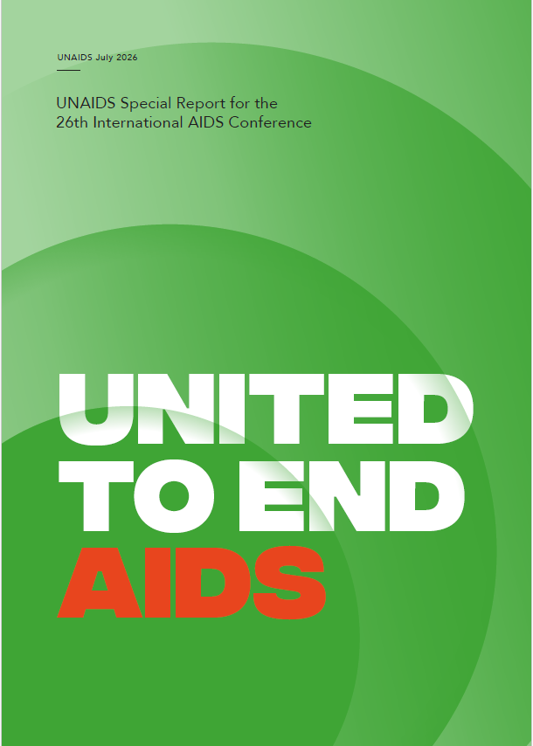

AIDS2026
Special report slides
22 July 2026

Slide 2
Table of contents
Intro
1. Momentum is faltering to end AIDS as a public health threat
1.1. Fragile HIV prevention programmes are at risk
1.2 Progress on treatment has been maintained—but for how long?
1.3 Essential community-led organizations supporting HIV prevention and treatment services are in jeopardy
2. A window for solidarity and transformation
2.1 Lifting societal barriers that impede progress
2.2 Access to innovations can amplify impact and optimize efficiency
2.3 Integration of HIV services into national systems shows promising results
2.4 Closing the funding gap and securing sustainable financing
3. The 2026 United Nations Political Declaration on HIV/AIDS: accelerating progress towards ending AIDS as a public health threat by 2030
3.1 – The Global AIDS Strategy - Three priorities to end AIDS as a public health threat by 2030
3.2 2026 High-level Meeting: renewed commitments and country-focused targets
All materials are under embargo until 14:00 BRT / 19:00 CET / 17:00 GMT on Monday 27 July, 2026

Slide 3
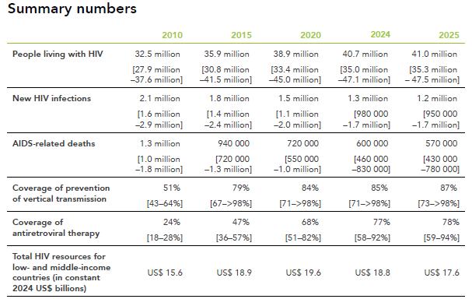

Slide 4

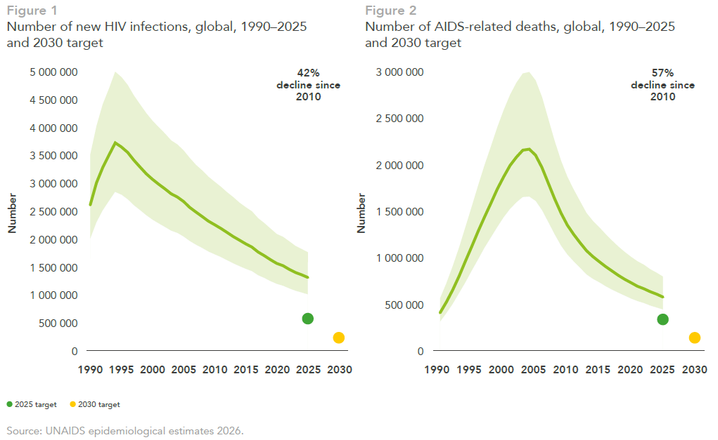
Despite progress, the world missed the 2025 targets
Notes:
Global new HIV infections declined from a peak of ~3.5 million in the late 1990s to about 1.3–1.4 million by 2025, but this remains well above the 2025 target, showing progress has been too slow to stay on track for 2030.
Deaths fell from over 2 million in the mid-2000s to around 600,000 in 2025 due to expanded treatment, yet they are still far above the 2025 target, confirming another missed milestone.
Despite real progress, the clear gap to both 2025 and 2030 targets (≤400,000 infections; ≤250,000 deaths) highlights that funding gaps, inequalities, and service disruptions are slowing progress urgent acceleration is needed to get back on track

Slide 5
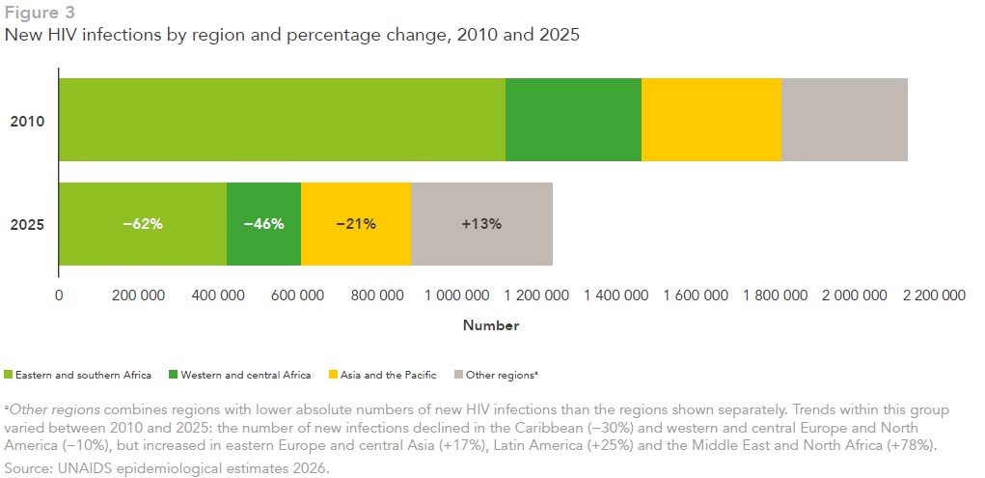
Progress in reducing numbers of new HIV infections has been greatest in sub-Saharan Africa
Notes:
New HIV infections declined between 2010 and 2025 in several regions: Eastern & Southern Africa(62%), Western & Central Africa (−47%), and Asia & the Pacific (−21%)while overall “other regions” saw a slight increase (+8%).
Sub-Saharan Africa remains the most affected region, accounting for about half of new HIV infections, despite achieving the largest reductions globally. With Funding cuts being the largest threat globally.

Slide 6
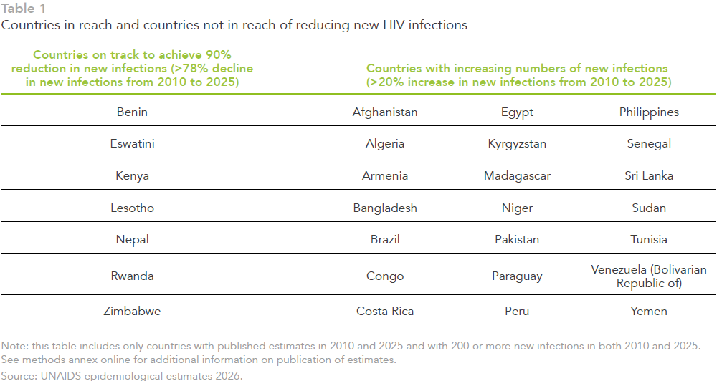
Some countries are still on track but at least 21 countries have increasing numbers of new HIV infections

Slide 7
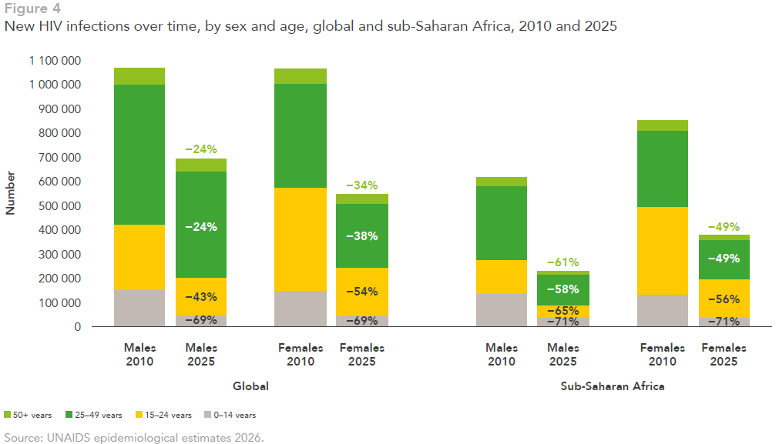
Declines in numbers of new acquisitions are slowest among men outside of sub-Saharan Africa, while women within sub-Saharan Africa have slower declines than their male counterparts
Notes:
Uneven progress: Globally and outside sub-Saharan Africa, new infections fell faster among women than men; within sub-Saharan Africa the pattern reverses, with men declining faster than women.
Women most affected: Women account for 60% of new infections in sub-Saharan Africa; adolescent girls and young women (15–24) saw about 160,000 new infections in 2025 (~3,000 per week), 3–4 times the male rate, amid faltering prevention funding.
Persistent service gaps: Programme gaps left 94,000 children newly infected in 2025 (84% in sub-Saharan Africa); treatment coverage for pregnant women reached just 87%, barely up from 84% in 2020.

Slide 8
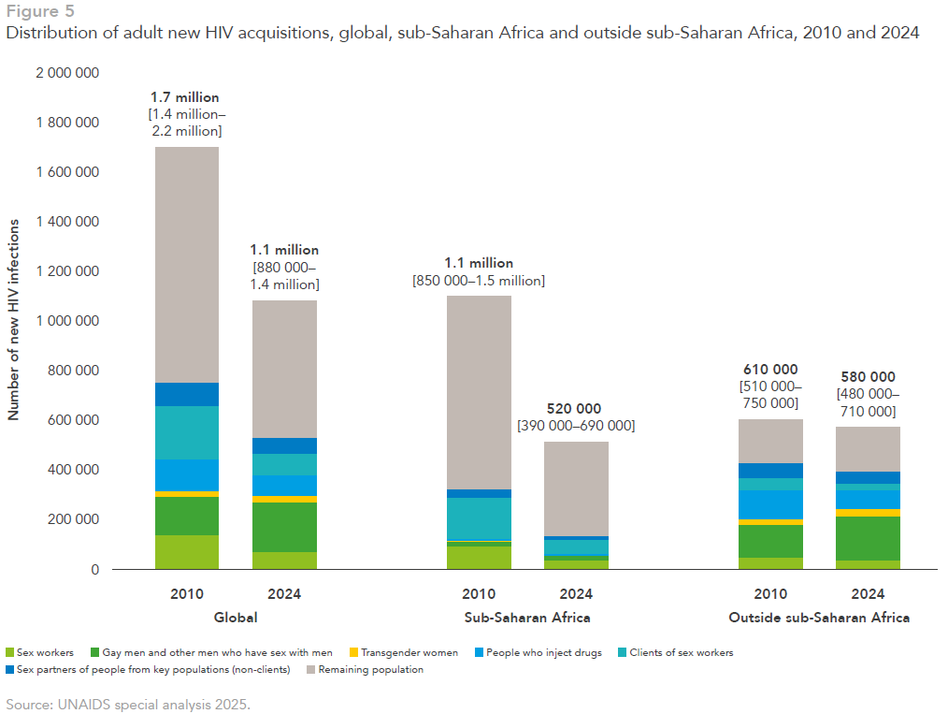
New HIV acquisitions among key populations persist
Notes:
Rising share and disproportionate risk among key populations: The proportion of new HIV infections among key populations and their partners increased from 44% in 2010 to 49% in 2024, with extremely high relative risk up to 34× higher for people who inject drugs, and 17–18× higher for other key groups.
Regional disparities in transmission patterns: In sub-Saharan Africa, heterosexual transmission dominates, with 26% of new infections linked to key populations, particularly sex workers and clients (18%), whereas outside the region, about two-thirds of infections occur among key populations especially gay men and other men who have sex with men (≈31%).
Critical program and service gaps persist: Insufficient, underfunded programmes mean key populations are still not fully benefiting from prevention, testing, and treatment services.

Slide 9
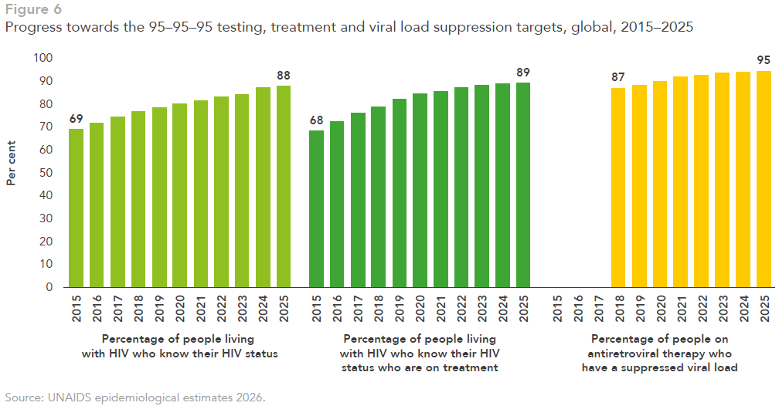
Progress towards the 95–95–95 targets for HIV testing, treatment and viral suppression has been maintained
Notes:
By end of 2025: 88% knew their HIV status, 89% of those diagnosed were on treatment, 95% of those on treatment were virally suppressed; 32.1 million people on treatment globally.
74% of all people living with HIV had suppressed viral load—closing this gap is critical, as undetectable viral load eliminates sexual and vertical transmission risk.
Progress is fragile: treatment growth slowed to 2.7% (from 4% average), community-led organizations face funding cuts, and regions remain heavily dependent on external financing (90% in western and central Africa, 38% in eastern and southern Africa in 2024).

Slide 10
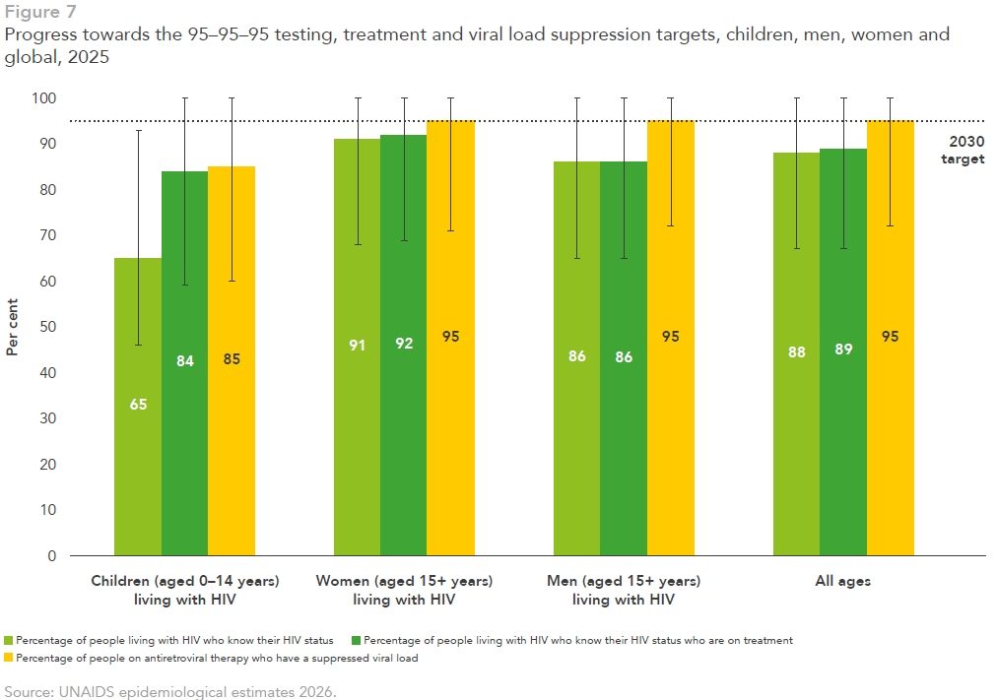
Despite progress towards the 95–95–95 targets for HIV testing, treatment and viral suppression, inequalities among populations remain
Notes:
Children are the most behind in the 95-95-95 cascade: Only 64% know their status and 54% are on antiretroviral therapy (over 580,000 children untreated), lagging significantly behind adults
Children represent 3% of people living with HIV but 11% of AIDS-related deaths, highlighting the urgent need to close the paediatric treatment gap
Gender gap persists: Men trail women globally (85–87–95 vs 91–92–95 cascade; 74% vs 84% treatment coverage), though viral suppression remains strong once on treatment (95%) across groups

Slide 11
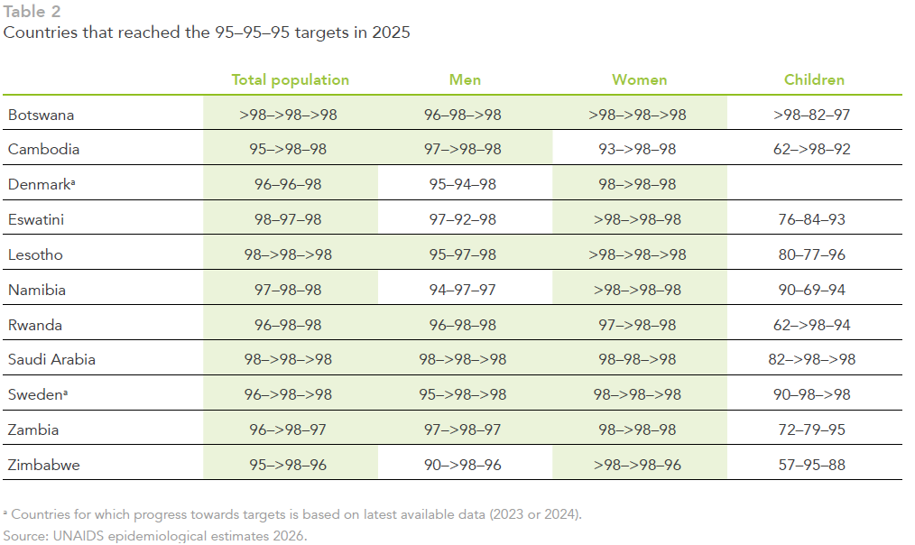
The 95-95-95 targets were achieved by 14 countries by 2025

Slide 12
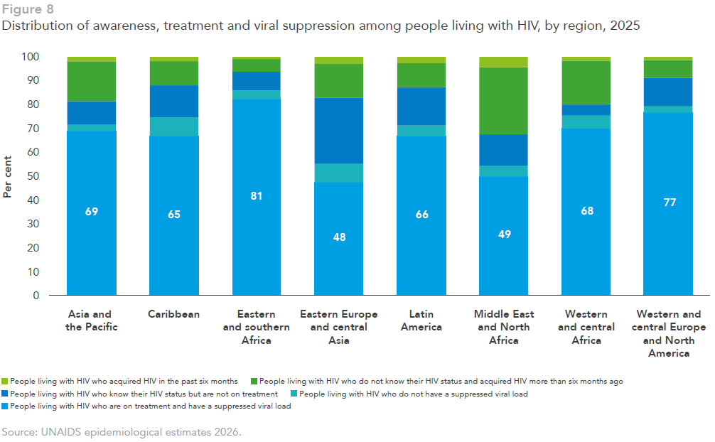
Disparities in viral suppression across regions
Notes:
Significant regional disparities in the HIV treatment cascade in 2025: Western & Central Europe/North America and Western & Central Africa achieve the highest overall viral suppression while Eastern Europe & Central Asia shows the largest gaps, with notably lower awareness and treatment coverage
High-performing regions (e.g. Western & Central Africa) demonstrate that strong treatment programs are achievable even in high-burden settings, with the majority of people living with HIV on treatment and virally suppressed
Although viral suppression is strong once on treatment in most regions, major losses occur earlier in linkage to care. Targeted efforts are urgently needed to close diagnosis and treatment gaps in underperforming regions to reach the global 95-95-95 targets

Slide 13
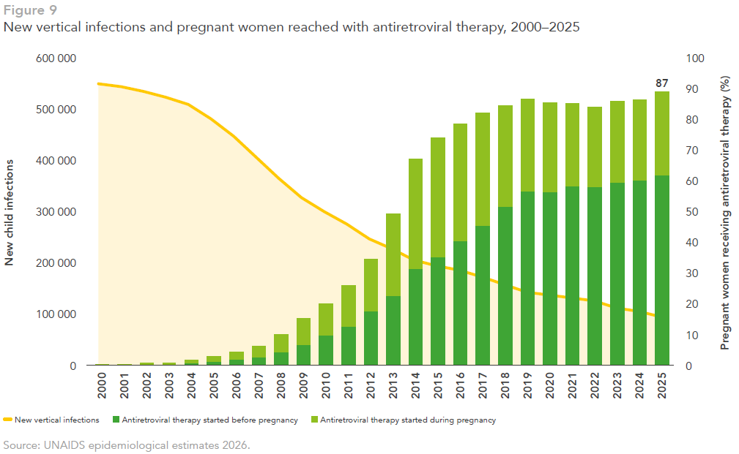
Providing women with HIV treatment for their own health and to reduce vertical transmission
Notes:
New vertical (mother-to-child) infections have fallen from around 550,000 in 2000 to 93,000 in 2025 — the first time this number has dropped below 100,000 since the early 1980s.
Coverage of pregnant women receiving antiretroviral therapy has risen to 88% in 2025, but that's only a slow increase from 85% in 2020 — progress has flattened in recent years.
More women are now starting treatment before becoming pregnant rather than during pregnancy, which further lowers transmission risk.

Slide 14
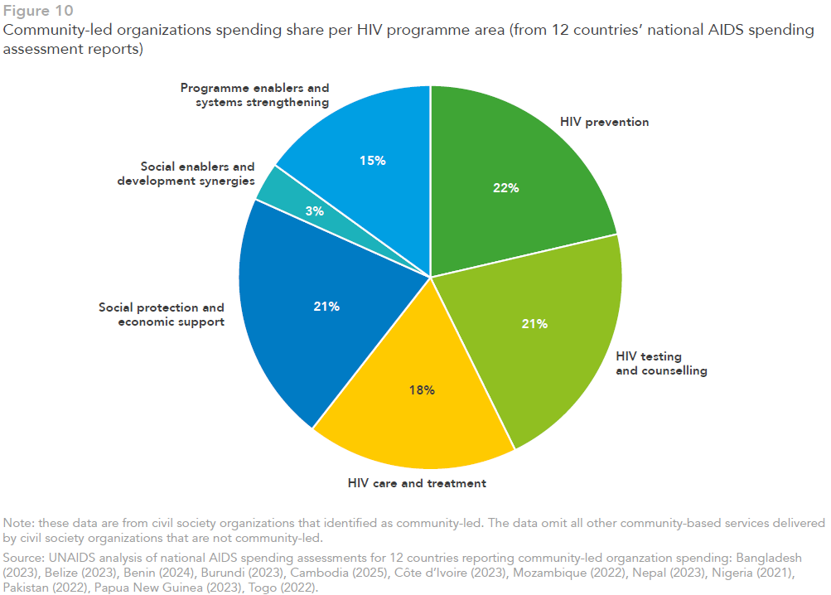
Community led organisations deliver critical services

Slide 15
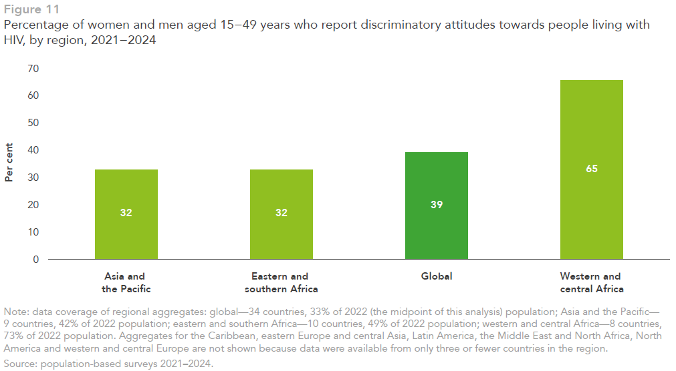
Discriminatory attitudes continue to exist in different regions
Notes:
Discriminatory attitudes towards people living with HIV remain widespread, with 39% of people aged 15–49 globally reporting such attitudes between 2021–2024
Highest levels observed in Western and Central Africa (65%), significantly above the global average, while Asia and the Pacific and Eastern and Southern Africa both stand at 32%
Persistent stigma and discrimination continue to undermine the HIV response by discouraging testing, treatment uptake, and community support urgent action is needed to address harmful attitudes, especially in high-prevalence regions

Slide 16
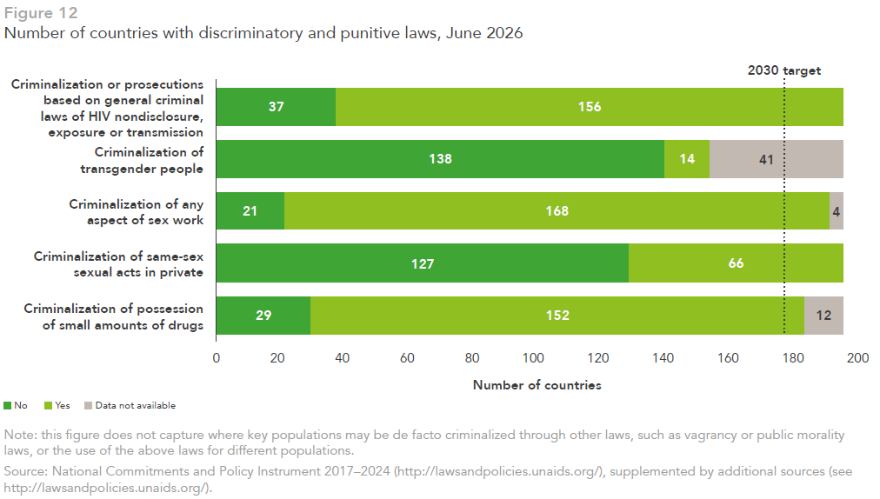
Criminalizing laws restrict access to HIV services
Notes:
Criminalizing laws continue to restrict access to HIV services in many countries as of June 2026, with punitive legislation remaining widespread across multiple areas
168 countries criminalize aspects of sex work, 156 criminalize HIV nondisclosure/exposure/transmission, and 152 criminalize possession of small amounts of drugs
These discriminatory and punitive laws undermine HIV prevention and treatment efforts for key populations urgent legal reform is essential to meet the 2030 targets and end AIDS as a public health threat

Slide 17
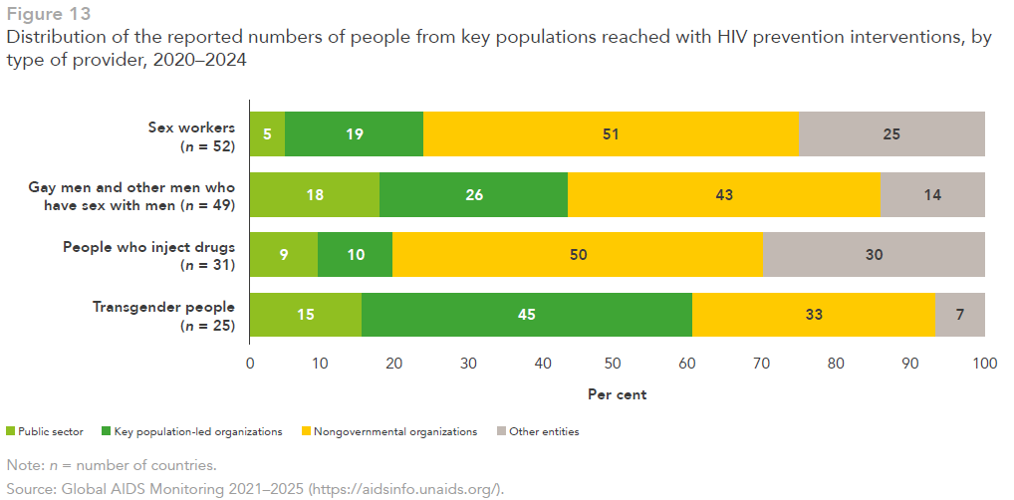
Community-led organizations are a critical delivery mechanism for HIV prevention, especially for key populations
Notes:
Across every key population shown, NGOs and key-population-led organizations combined deliver 60–70% of prevention services — sex workers (70%), gay men and other MSM (69%), people who inject drugs (60%), transgender people (60%) — making them the dominant delivery channel, not the public sector.
Public sector presence is thinnest exactly where community-led delivery is strongest: just 9% for people who inject drugs and 15% for transgender people, versus a relatively larger 18% for gay men and other MSM.
This matters strategically: The populations hardest to reach through mainstream health systems are served almost entirely through community and NGO channels — which are precisely the programmes most exposed to the funding cuts detailed earlier in the deck .

Slide 18
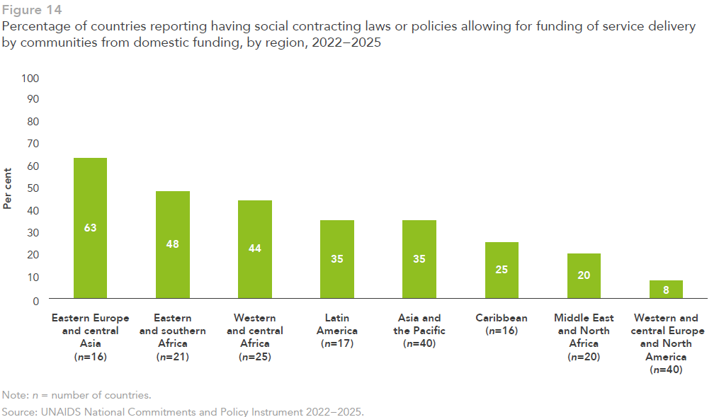
Efforts to put in place social contracting mechanisms must be continued
Notes:
Efforts to put in place social contracting mechanisms must be continued as only a minority of countries have laws or policies allowing domestic funding for community service delivery, with the highest coverage in Eastern Europe & Central Asia (63%), Eastern & Southern Africa (48%), and Western & Central Africa (44%)
Progress remains uneven and generally low across most regions (as low as 8% in Western & Central Europe/North America), making sustained domestic funding for community-led organizations essential for a resilient HIV response.

Slide 19
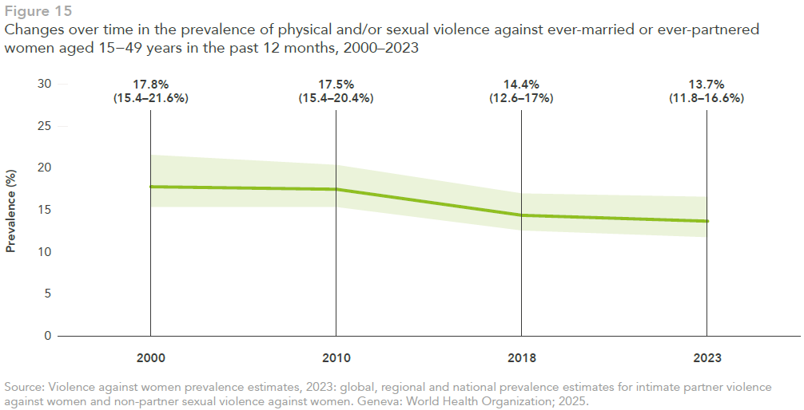
There has been no significant progress in reducing domestic violence since 2000 globally
Notes:
Prevalence of physical and/or sexual violence against ever-married or ever-partnered women aged 15–49 only declined slightly from 17.8% (2000) to 13.7% (2023)
The slow pace of decline highlights the urgent need for stronger efforts to address gender-based violence, which continues to fuel the HIV epidemic by increasing vulnerability, especially among women and girls

Slide 20
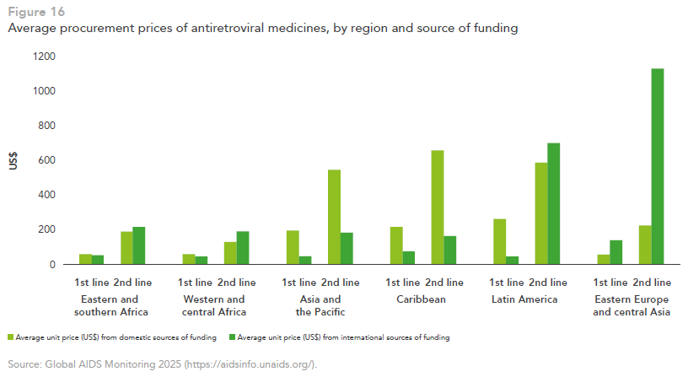
The price of HIV-related medicines varies greatly across regions
Notes:
Significant differences exist in average procurement prices of 1st and 2nd line antiretrovirals, with the highest costs seen in Eastern Europe & Central Asia (especially 2nd line medicines from international sources exceeding $1,100 per unit) and much lower prices in Eastern & Southern Africa
Heavy reliance on more expensive international procurement in some regions reduces the efficiency of HIV funding and limits treatment scale-up . Greater use of domestic sourcing, pooled procurement, and price negotiation is needed to improve affordability and sustainability

Slide 21
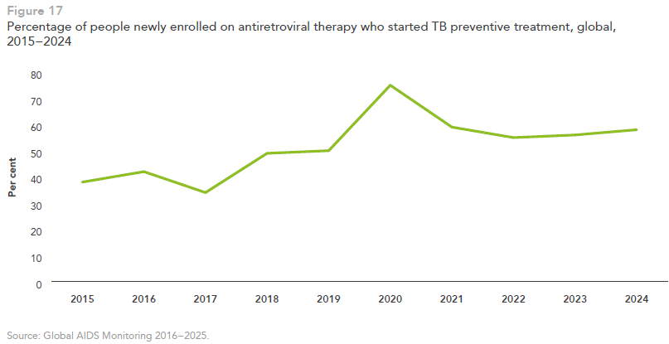
Progress in integration of HIV with TB services
Notes:
The percentage of people newly enrolled on antiretroviral therapy who started TB preventive treatment increased from 39% in 2015 to 59% in 2024, with a peak of 77% in 2020
While integration efforts showed gains, the decline after 2020 and current plateau highlight the need to strengthen and sustain TB preventive treatment coverage for people living with HIV to reduce co-infection mortality

Slide 22
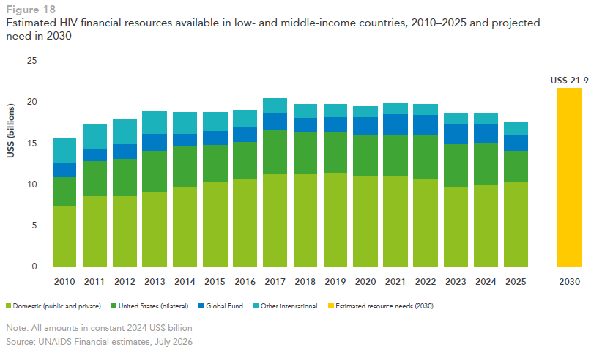
HIV funding declined
Notes:
Achieving the 2030 targets requires US$21.9 billion annually, but only US$17.6 billion was available in 2025 — a US$4.3 billion gap, or nearly a quarter of what's needed.
Total resources have essentially plateaued since 2017 (around US$18-20 billion/year) rather than growing to meet rising need, and 2025 marks the sharpest funding contraction in this timeframe.
Closing this gap is central to the 2026 Political Declaration's financing pillar — sustained and diversified investment, not just donor replenishment, will determine whether the 2030 targets are reachable

Slide 23
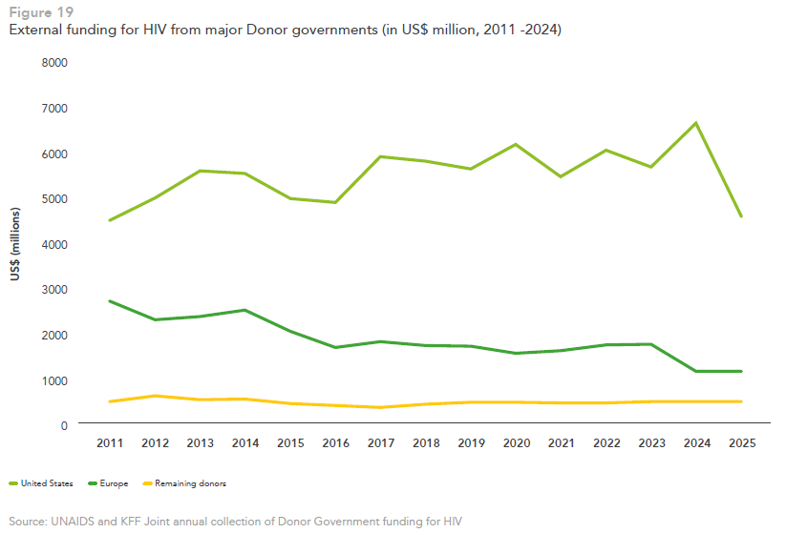
Evolution of HIV financing 2011-2025
Notes:
"Europe" includes the donor governments highlighted in the KFF/UNAIDS report (Denmark, France, Germany, Ireland, Italy, Kingdom of the Netherlands, Norway, Spain, Sweden, and the United Kingdom) and the European Commission.
"Remaining donors" include other Development Assistance Committee (DAC) members that are not highlighted in the KFF/UNAIDS report, as well as non-Development Assistance Committee donor governments that have contributed to multilateral organizations (Global Fund, UNAIDS, Unitaid).
Source: KFF/UNAIDS joint analysis of donor government disbursements for HIV (2011–2025).

Slide 24
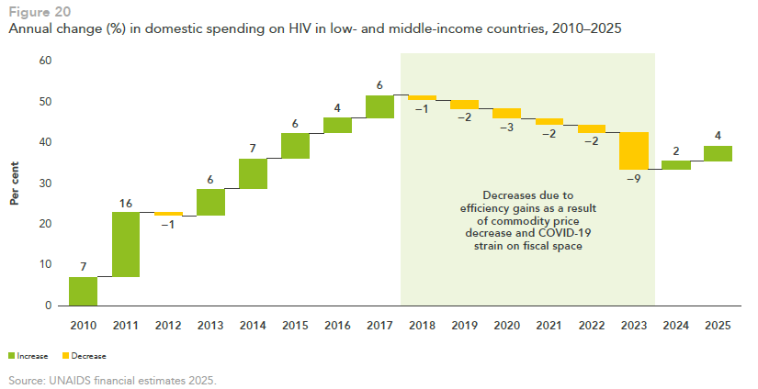
Domestic spending on HIV grew in 2025 for the second time since the COVID-19 pandemic
Notes:
Annual domestic funding in low- and middle-income countries increased by +4% in 2025, reversing a trend of consecutive declines from 2018 to 2023 (including a -9% drop in 2023)
While this modest rebound is encouraging, domestic investment remains critical for long-term sustainability continued growth in domestic funding is essential to offset declining external aid and support a resilient HIV response

Slide 25
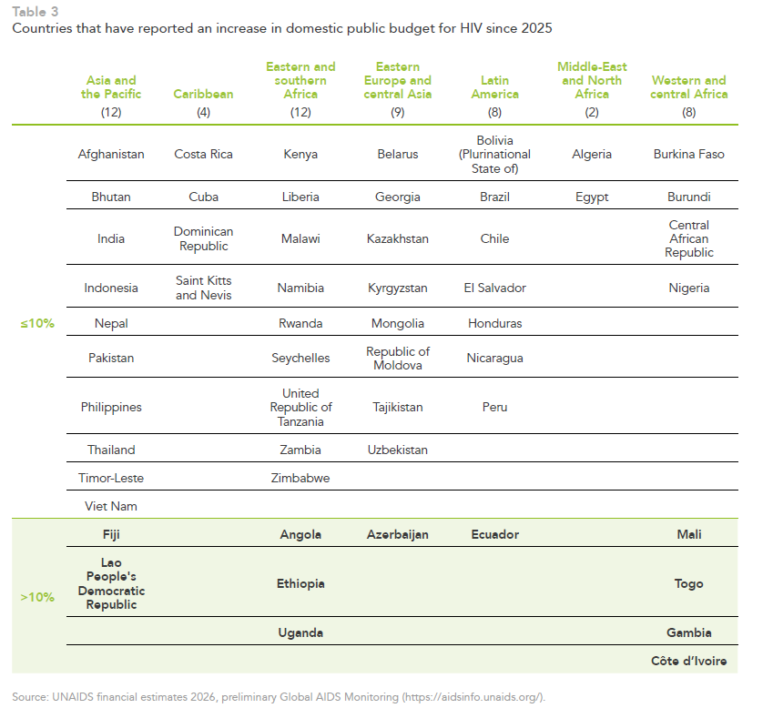
Over 55 countries reported planned increases in domestic funding for HIV since 2025
Notes:
Over 54 countries across multiple regions (including Africa, Asia-Pacific, and Latin America) have reported planned increases in domestic HIV funding since 2025, signaling strong political commitment.
Most countries plan moderate increases (<10%), while a smaller group (e.g., Uganda, Ethiopia, Angola) are planning larger increases (>10%), showing differing fiscal capacity and prioritization.
Despite global funding pressures, many countries are stepping up domestic investment, but the scale and consistency of increases will be critical to closing resource gaps and achieving 2030 targets.

Slide 26
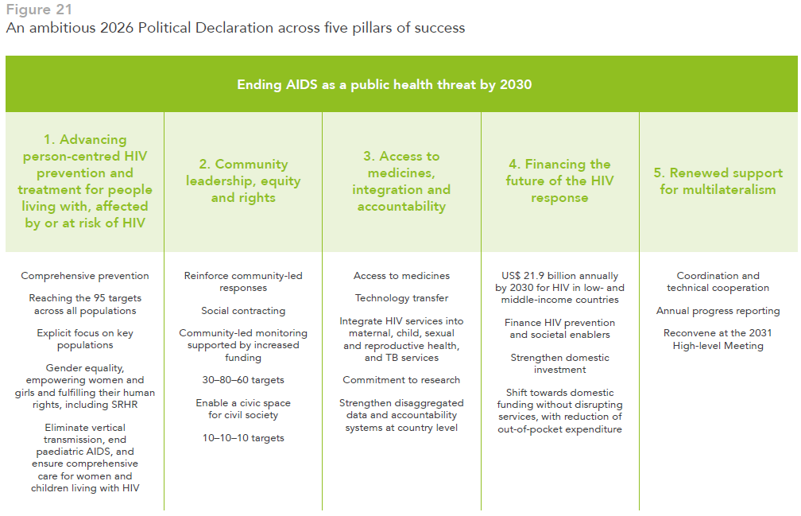
At a glance: five pillars of success for the
2026 Political Declaration on ending AIDS by 2030
Notes:
In June 2026, 149 Member States adopted the new Political Declaration on HIV/AIDS, aligned with the UNAIDS Global AIDS Strategy 2026–2031 and all the 2030 targets.
The new commitments made by Member States as part of the 2026 Political Declaration fall under five pillars, which recognize that ending AIDS as a public health threat requires more than biomedical tools.
The five pillars call for advancing per-centred HIV prevention, treatment and people living with, affected by or at risk of HIV (pillar 1), community leadership (pillar 2), access to medicines, integration and accountability (pillar 3), financing the future of the HIV response (pillar 4) and renewed support for multilateralism (pillar 5)

Slide 27
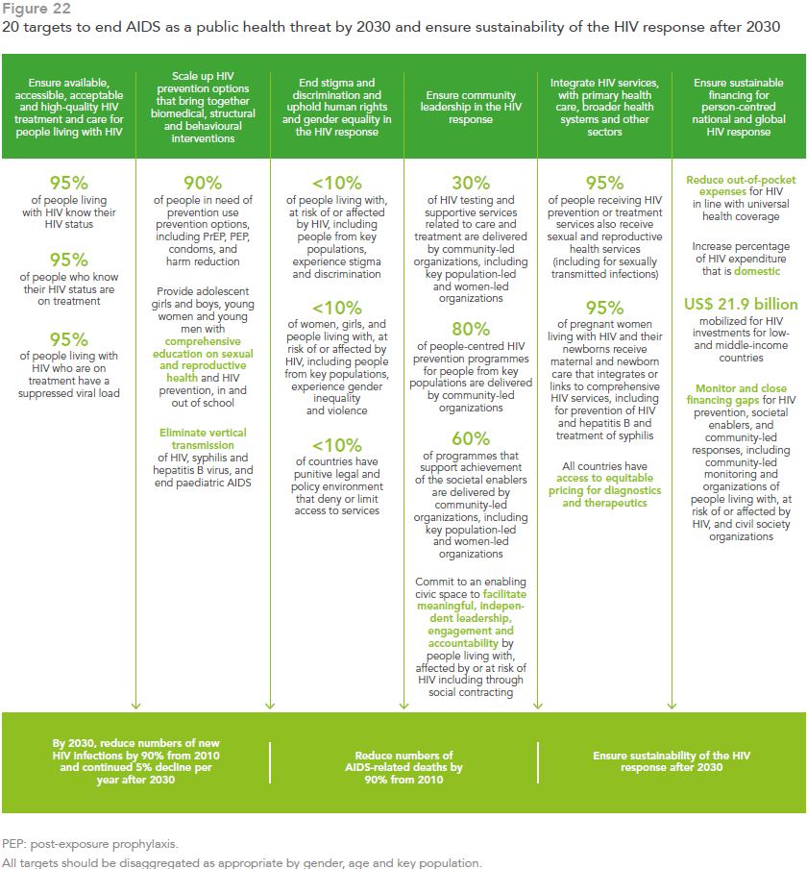
20 targets to end AIDS as a public health threat by 2030 and ensure sustainability of the HIV response after 2030
Notes:
This slide summarises the 20 global targets agreed in the political declaration and needed to end AIDS as a public health threat by 2030, spanning prevention, treatment, inequalities, community leadership, and sustainable financing.
This includes the 16 global targets of Global AIDS Strategy that were developed by the Global Task team on targets, the GTT, in 2024 a multistakeholder task team of countries, civil society, academia, and UNAIDS cosponsors.
Key targets adopted included 95–95–95 treatment outcomes and 90% access to prevention services, alongside reducing inequalities so that less than 10% of people experience stigma, discrimination, or service barriers.
It also includes 4 new targets negotiated in New York (with black boxes here)
Access to education on sexual and reproductive health and HIV prevention for young people in and out of school,
Elimination of vertical transmission of HIV and end pediatric AIDS
Monitor and fully fund HIV prevention, societal enablers and communities,
Protecting civic space to enable communities to lead and ensure accountability on the HIV response
The new 2030 targets also topline numerical targets include 40 million people on life-saving treatment of which 38 million are virally suppressed, 20 million people with access to antiretroviral-based prevention, zero people facing stigma and discrimination and a global funding commitment of 21.9bn by 2030.

Slide 28
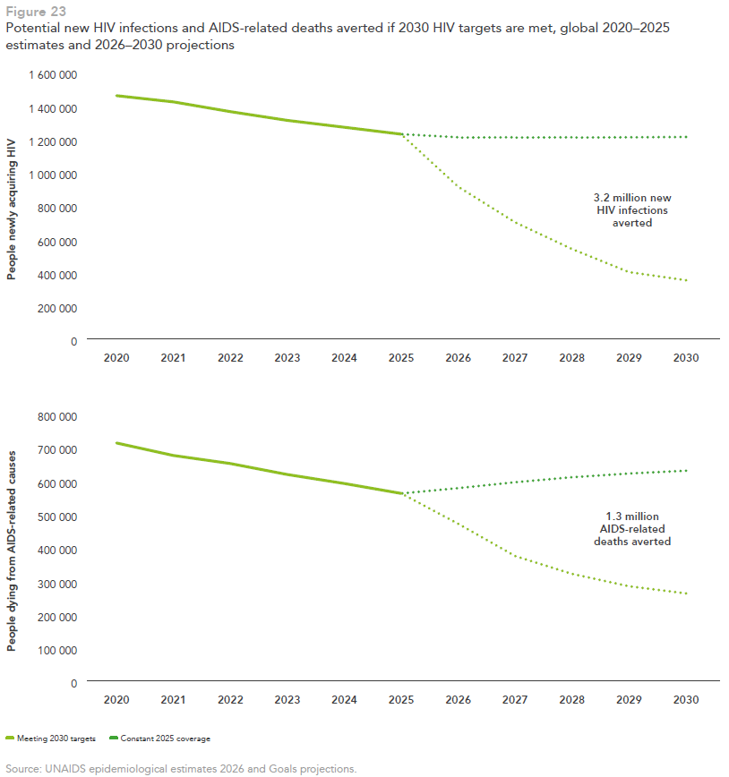
Potential new HIV infections and AIDS-related deaths averted if 2030 HIV targets are met, global 2020–2025 estimates and 2026–2030 projections
Notes:
Achieving 2030 targets would sharply reduce new infections to ~400,000 annually, averting an estimated 3.2 million infections between 2025–2030 compared to current trends.
Accelerated progress would also cut AIDS-related deaths to ~250,000 per year, preventing about 1.3 million deaths over the same period.
The comparison shows that maintaining current coverage is not enough—scaling up interventions now can save millions of lives by 2030.
Achieving these targets would result in dramatic reductions in new infections and deaths, while ensuring a sustainable, equitable HIV response beyond 2030.

Slide 29
Thank you
More information: https://aidsinfo.unaids.org/

